Slide 1

WEB SERVICES OPERATIONS
Made By: ISHA EMAN & KAINAT ZAFFAR
Submitted To: Miss AREEJ ALI
(Group- 4)

Slide 2

Table Of Content
What is Web Services?
Architecture of Web Services:
Roles in a Web Service Architecture
Operations in Web Service Architecture
Web Service Operations:
Get
Post
Put
Delete
Search

Slide 3
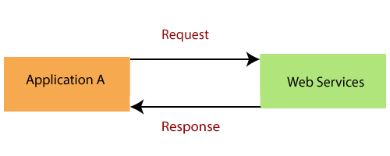
What is Web Services? Web services are the types of internet software that uses standardized messaging protocol over the distributed environment. It integrates the web-based application using the REST, SOAP, WSDL, and UDDI over the network. For example, Java web service can communicate with .Net application.

Slide 4
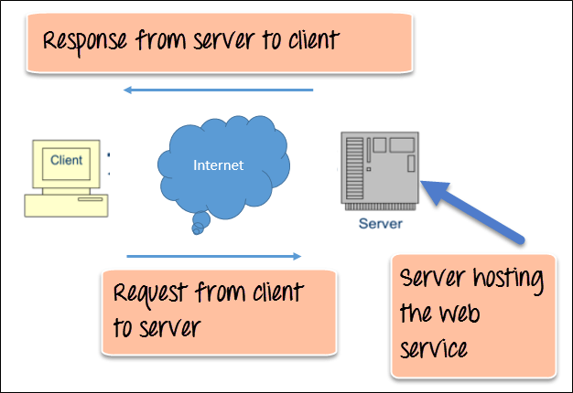
Architecture of Web Services

Slide 5
Architecture of Web Services
The Web Services architecture describes how to instantiate the elements and implement the operations in an interoperable manner.
The architecture of web service interacts among three roles: service provider, service requester, and service registry.
The interaction involves the three operations: publish, find, and bind. These operations and roles act upon the web services artifacts.

Slide 6
Architecture of Web Services
The service provider hosts a network-associable module (web service). It defines a service description for the web service and publishes it to a service requestor or service registry.
These service requestor uses a find operation to retrieve the service description locally or from the service registry.
It uses the service description to bind with the service provider and invoke with the web service implementation.

Slide 7
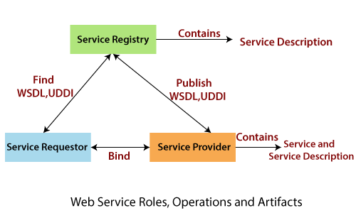
Architecture of Web Services

Slide 8
Architecture of Web Services
Roles in a Web Service Architecture:
There are three roles in web service architecture:
Service Provider
Service Requestor
Service Registry

Slide 9
Architecture of Web Services
Roles in a Web Service Architecture:
Service Provider:
From an architectural perspective, it is the platform that hosts the services.
2. Service Requestor:
Service requestor is the application that is looking for and invoking or initiating an interaction with a service. The browser plays the requester role, driven by a consumer or a program
without a user interface.
3. Service Registry:
Service requestors find service and obtain binding information for services during development.

Slide 10
Architecture of Web Services
Operations in a Web Service Architecture:
Three behaviors that take place in the microservices:
Publication of service descriptions (Publish)
Finding of services descriptions (Find)
Invoking of service based on service descriptions (Bind)

Slide 11
Architecture of Web Services
Operations in a Web Service Architecture:
Publish: In the publish operation, a service description must be published so that a service requester can find the service
Find: In the find operation, the service requestor retrieves the service description directly. It can be involved in two different lifecycle phases for the service requestor:
1. At design, time to retrieve the service's interface description for program development.
2. And, at the runtime to retrieve the service's binding and location description for invocation.
Bind: In the bind operation, the service requestor invokes or initiates an interaction with the service at runtime using the binding details in the service description to locate, contact, and invoke the service.

Slide 12
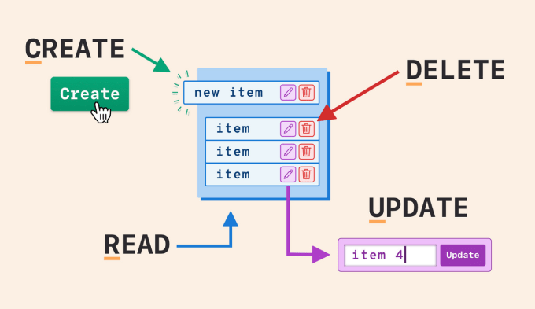
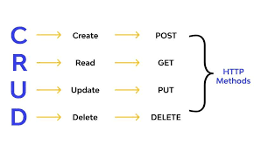
Web Service Operations Web service operations refer to the methods or functions provided by a web service that can be accessed and invoked remotely using standard web protocols such as HTTP or SOAP. These operations allow clients to interact with and request data from the web service, making it a powerful tool for sharing and exchanging information between different systems and applications.

Slide 13
Web Service Operations
1. Get: This operation is used to retrieve data or information from a web service. The client sends a request to the web service, specifying the data to be retrieved and the web service returns the requested data in response.
Example:
import java.net.*;
import java.io.*;
public class WeatherServiceClient {
public static void main(String[] args) throws Exception {
URL url = new URL("http://weather.com/gettemp?location=NewYork");
HttpURLConnection con = (HttpURLConnection) url.openConnection();

Slide 14
Web Service Operations
con.setRequestMethod("GET");
BufferedReader in = new BufferedReader(new InputStreamReader(con.getInputStream()));
String inputLine;
StringBuffer response = new StringBuffer();
while ((inputLine = in.readLine()) != null) {
response.append(inputLine);
}
in.close();
System.out.println(response.toString());
}
}

Slide 15
Web Service Operations
2. Post: This operation is used to submit or create new data in a web service. The client sends data to a web service using the HTTP Post method, and the web service creates a new record or object in response.
Example:
import java.net.*;
import java.io.*;
public class ShoppingCartClient {
public static void main(String[] args) throws Exception {
URL url = new URL("https://example.com/add-to-cart");
HttpURLConnection con = (HttpURLConnection) url.openConnection();
con.setRequestMethod("POST");

Slide 16
Web Service Operations
con.setDoOutput(true);
String data = "product_id=123&quantity=2";
OutputStream os = con.getOutputStream();
os.write(data.getBytes());
os.flush();
os.close();
BufferedReader in = new BufferedReader(new InputStreamReader(con.getInputStream()));
String inputLine;
StringBuffer response = new StringBuffer();
while ((inputLine = in.readLine()) != null) {
response.append(inputLine);
}
in.close();
System.out.println(response.toString());}}

Slide 17
Web Service Operations
3. Put: This operation is used to update existing data or records in a web service. The client sends updated data to a web service using the HTTP PUT method, and the web service updates the records accordingly.
Example:
import java.net.*;
import java.io.*;
public class ReservationClient {
public static void main(String[] args) throws Exception {
URL url = new URL("https://example.com/update-reservation");
HttpURLConnection con = (HttpURLConnection) url.openConnection();
con.setRequestMethod("PUT");
con.setDoOutput(true);

Slide 18
Web Service Operations
String data = "reservation_id=123&checkin_date=2022-01-15&room_type=deluxe";
OutputStream os = con.getOutputStream();
os.write(data.getBytes());
os.flush();
os.close();
BufferedReader in = new BufferedReader(new InputStreamReader(con.getInputStream()));
String inputLine;
StringBuffer response = new StringBuffer();
while ((inputLine = in.readLine()) != null) {
response.append(inputLine);
}
in.close();
System.out.println(response.toString());
}
}

Slide 19
Web Service Operations
4. Delete: This operation is used to remove or delete records or data from a web service. The client sends a request to the web service using the HTTP DELETE method and the web service removes the requested data.
Example:
import java.net.*;
import java.io.*;
public class DeletePostClient {
public static void main(String[] args) throws Exception {
URL url = new URL("https://example.com/delete-post");
HttpURLConnection con = (HttpURLConnection) url.openConnection();

Slide 20
Web Service Operations
con.setRequestMethod("DELETE");
BufferedReader in = new BufferedReader(new InputStreamReader(con.getInputStream()));
String inputLine;
StringBuffer response = new StringBuffer();
while ((inputLine = in.readLine()) != null) {
response.append(inputLine);
}
in.close();
System.out.println(response.toString());
}
}

Slide 21
Web Service Operations
5. Search: This operation is used to search for specific data or records within a web service. The client sends a search request to the web service, specifying the search criteria, and the web service returns matching records or data.
Example:
import java.net.*;
import java.io.*;
public class SearchProductsClient {
public static void main(String[] args) throws Exception {
URL url = new URL("https://example.com/search-products?category=electronics&price_range=$100-$500");
HttpURLConnection con = (HttpURLConnection) url.openConnection();

Slide 22
Web Service Operations
con.setRequestMethod("GET");
BufferedReader in = new BufferedReader(new InputStreamReader(con.getInputStream()));
String inputLine;
StringBuffer response = new StringBuffer();
while ((inputLine = in.readLine()) != null) {
response.append(inputLine);
}
in.close();
System.out.println(response.toString());
}
}

Slide 23

Thank you

